Slide 1
EFFECTS OF JOB TRAINING ON WAGES
Team 2 (Go Blue!)

Slide 2
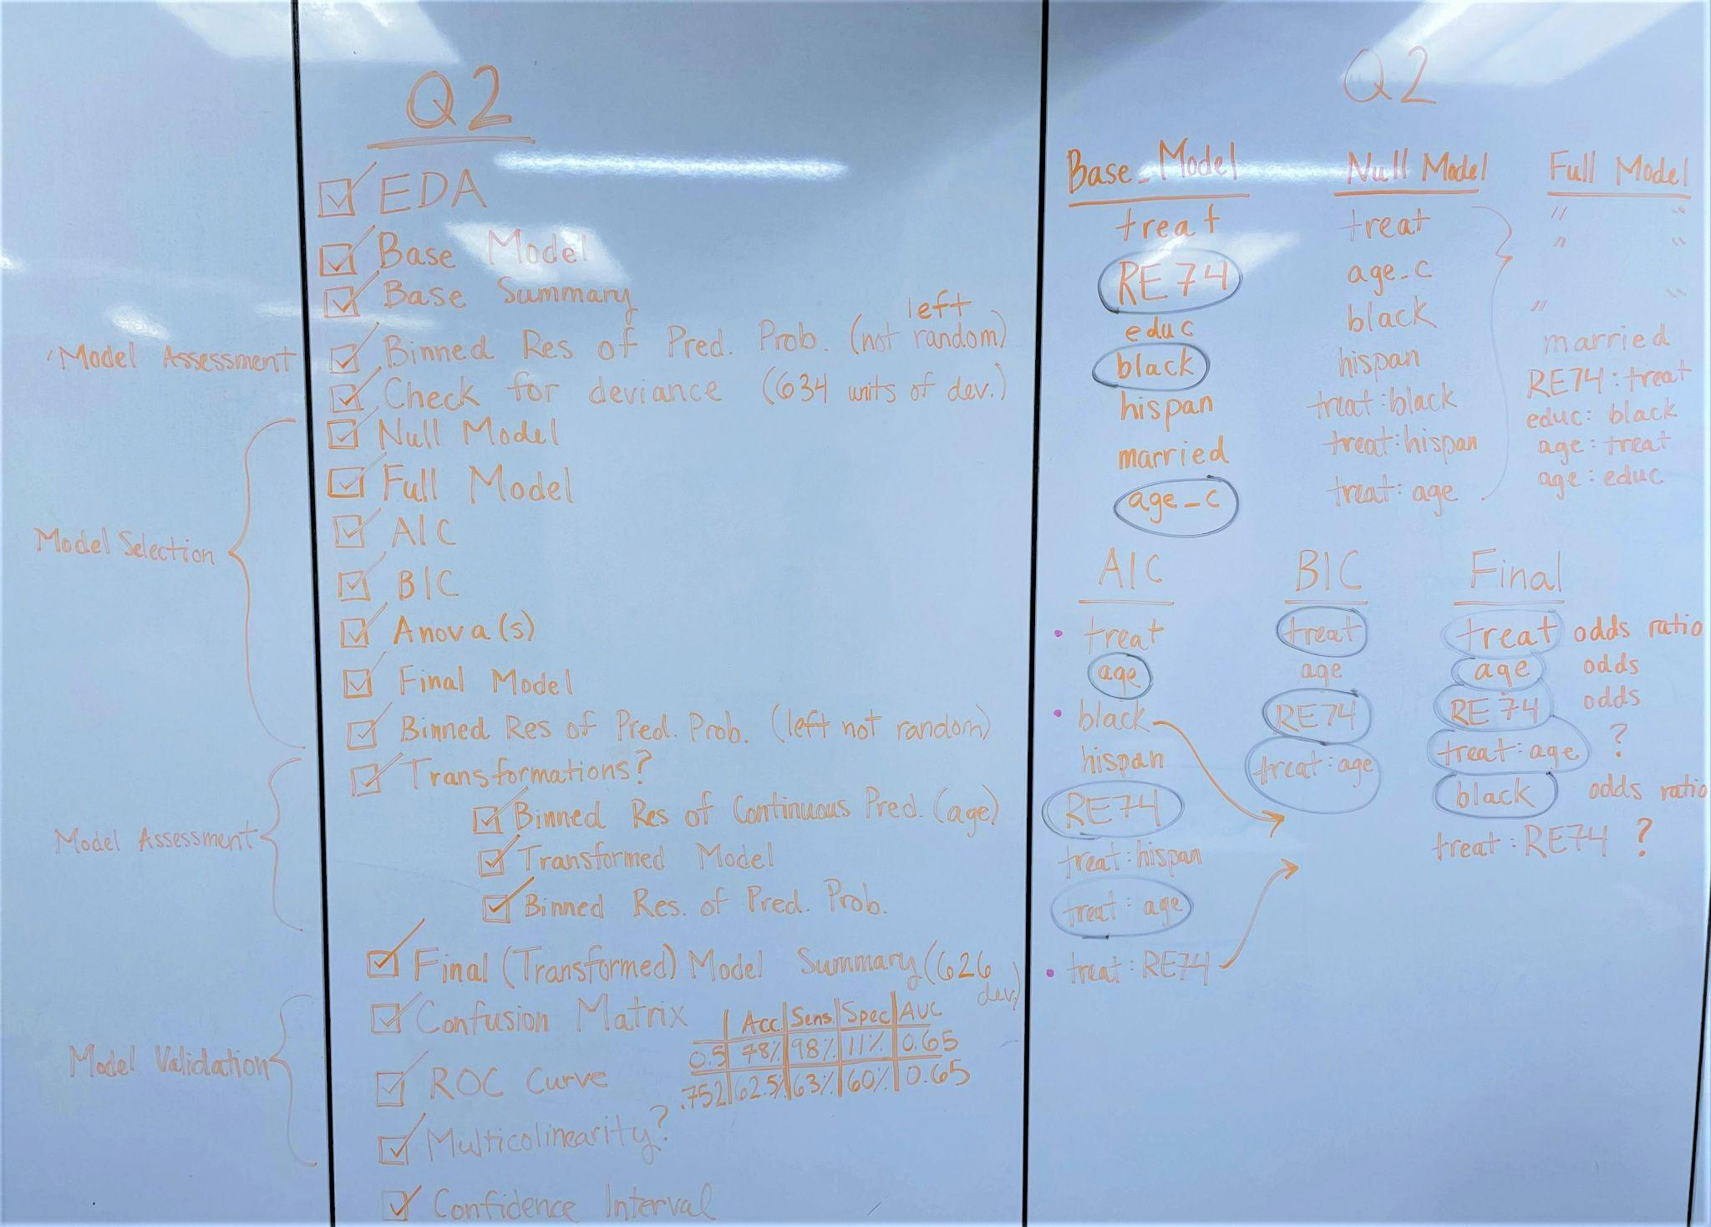
Notes:
Deekshita

Slide 3
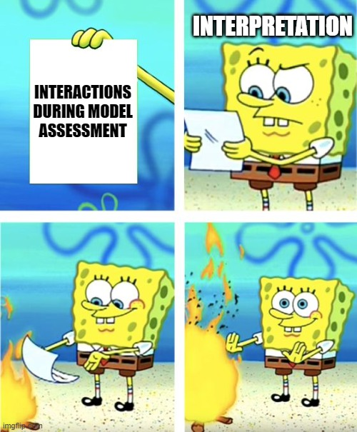
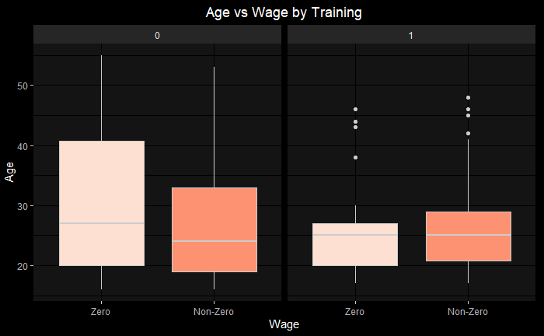
EDA
Some interactions that we are interested in :
treat:re74
treat:age_c
treat:black
treat:hispan
educ:black
educ:age_c

Slide 4

Model Selection
AIC
BIC
AIC
Proposed
BIC
treat
treat
treat
age_c
age_c
age_c
re74
re74
re74
treat:age_c
treat_age_c
treat:age_c
Our model
black
black
treat:re74
treat:re74
hispan
treat:hispan
Notes:
AIC
# Model call - re78Bi_F ~ treat + age_c + black + hispan + re74 + treat:hispan +
# treat:age_c + treat:re74
BIC
# Model call - re78Bi_F ~ treat + age_c + re74 + treat:age_c
Final_Model <- glm(formula = re78Bi_F ~ treat + age_c + re74 + black
+ treat:age_c + treat:re74, family = binomial,
data = nsw)

Slide 5
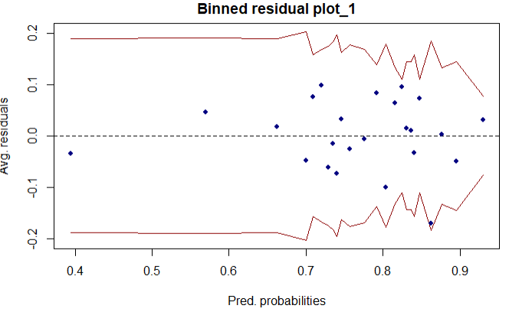
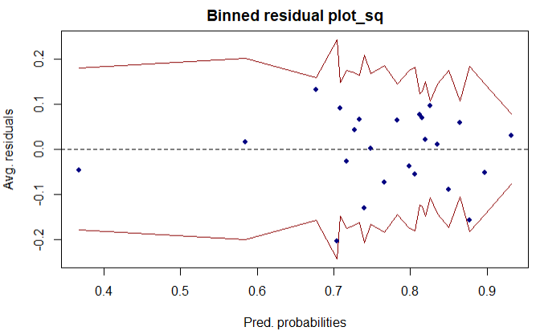

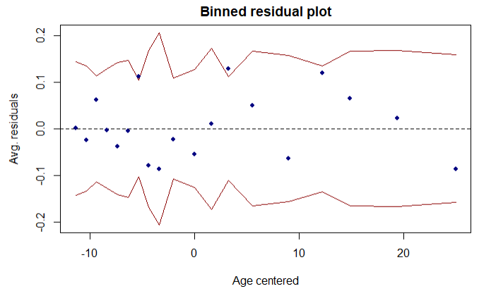
Model Assessment
Notes:
Sydney

Slide 6

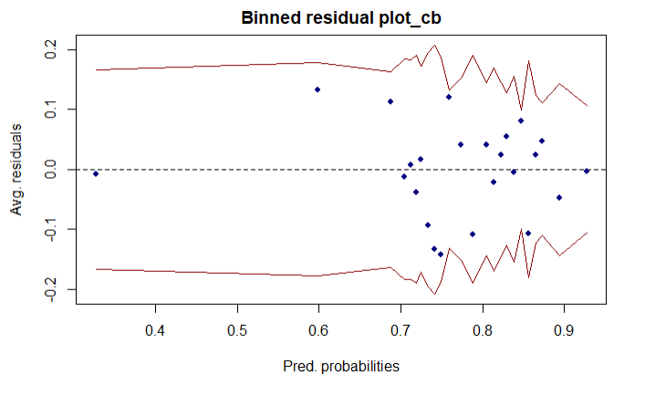
age²
age
age³

Slide 7

Model Performance
specificity
sensitivity
Effects in our Final Model
age_c | re74 | treat1 | black1 | age_c:treat1 | re74:treat1
Threshold | Accuracy | Sensitivity | Specificity | AUC
0.5 | 78% | 98% | 11% | .65
0.752 | 62.5% | 63% | 60% | .65
Notes:
Aarushi

Slide 8
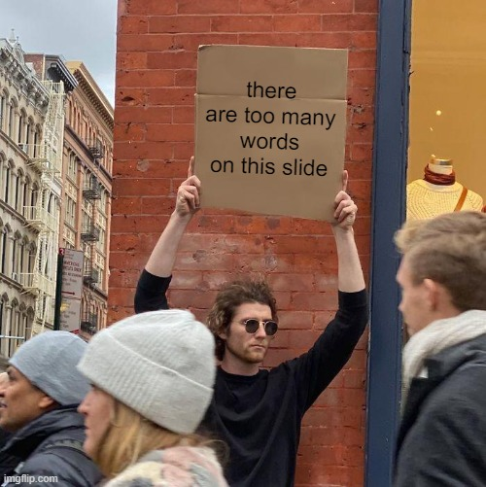
Interpretations
Intercept | age_c | re74 | treat1 | black1 | age_c:treat1 | re74:treat1
2.774 | 0.945 | 1.000 | 1.892 | 0.549 | 1.079 | 1.000
Intercept: For a non-black person aged 27 years, and unemployed in 1974, the odds of earning positive wages in 1978 without training is 2.77.
Age_c (Centered Age): For a person who did not receive training, a 1 year increase in age decreases the odds of earning positive wages by 5.5%
Re74 (Real Annual Earnings in 1974): For a person who did not receive training, a $1 increase in the earnings of 1974, increases the odds of earning positive wages by 0.01%. (sad :( )
Treat1 (Participant received training): For an unemployed person in 1974 aged 27, the odds of earning positive wages after receiving training is 1.89 times the odds of a person who did not receive training.
Black1 (Participant is black): The odds of a black person earning positive wages is 0.54 times the odds of a non-black person earning positive wages.
Age_c : Treat1: For a person who participated in the training, we see that a 1 year increase in age can lead to an increase in the odds of earning a non-zero wage by 1.9% ( 0.945 x 1.079 = 1.019)
Notes:
Anas

Slide 9
MERCI!
Questions? (Hopefully NONE)

